Slide 1
Video Inpainting
B04902040 王郁婷 B04902103 蔡昀達

Slide 2
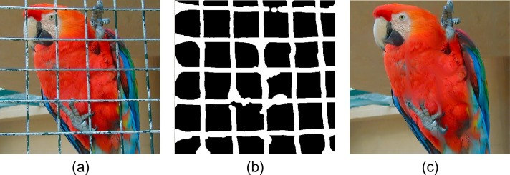
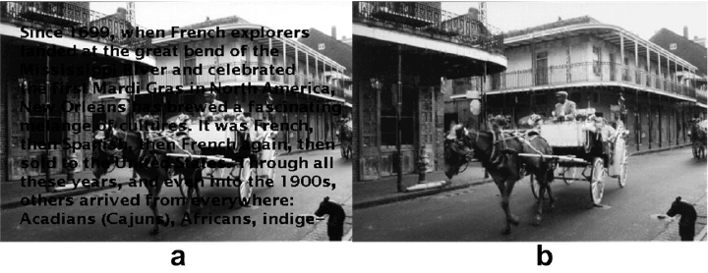
Motivation
restore error concealment
remove undesired objects/text
restore scratches or damages in vintage films
Cage removal
Text removal

Slide 3
Problem Definition
Large object inpainting
Texture & structure restoration
Motion consistency

Slide 4
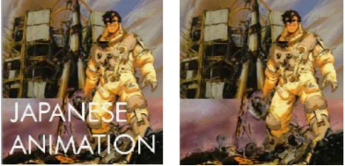
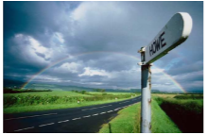
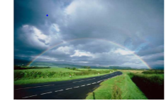
Region Filling and Object Removal by Exemplar-Based Image Inpainting
A. Criminisi, P. Perez, and K. Toyama
IEEE Transactions on Image Processing, vol. 13, no. 9, sep 2004

Slide 5
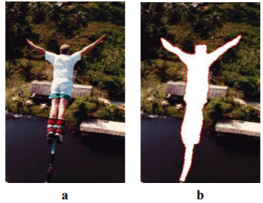
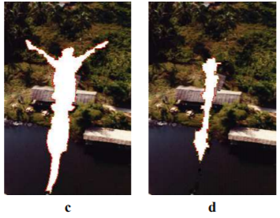
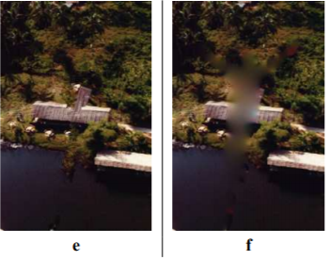
Exemplar-Based Image Inpainting
exemplar-based texture synthesis contains the essential process required to replicate both texture and structure
by performing the fill at the patch level as opposed to the pixel level, the algorithm reduces blurring artifacts caused by traditional image inpainting

Slide 6
Exemplar-Based Video Inpainting Approach Using Temporal Relationship of Consecutive Frames
Kuo-Lung Hung , Shih-che Lai
2017 IEEE 8th International Conference on Awareness Science and Technology (iCAST 2017)

Slide 7
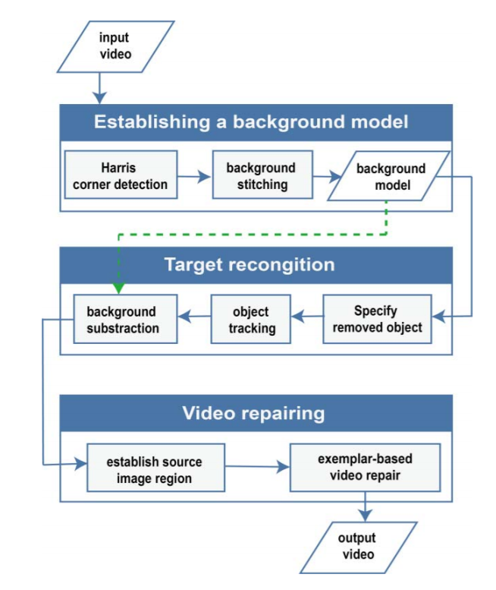
System
Architecture Diagram

Slide 8
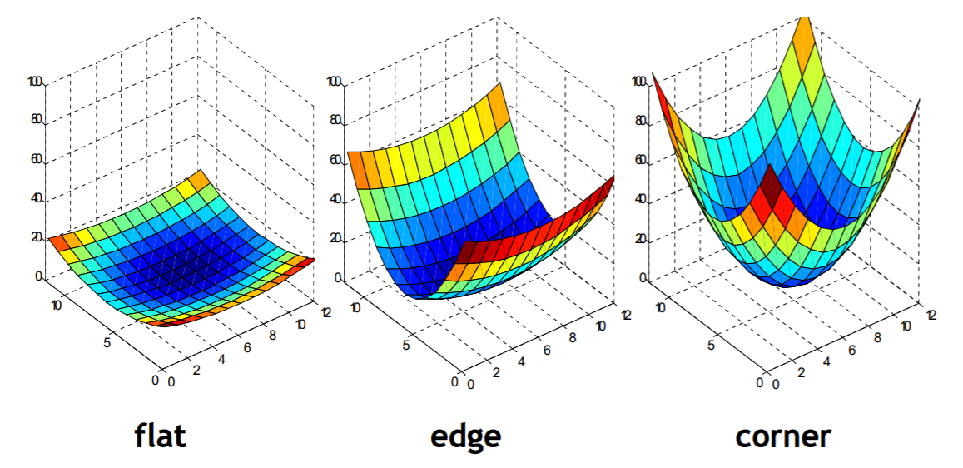
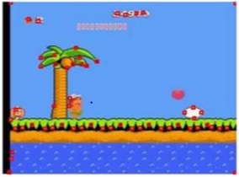
Harris Corner Detection
Establishing a Background Model
Target Recognition
Video Repairing
high robustness against affine transform
extract feature points of each frames and matching them between consecutive frames
Notes:
we only take the top 10 feature points with higher credibility to compare,
In which, credibility is the eigenvalue calculated in Harris’s algorithm

Slide 9
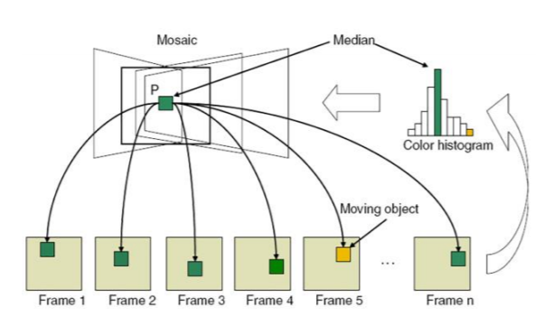
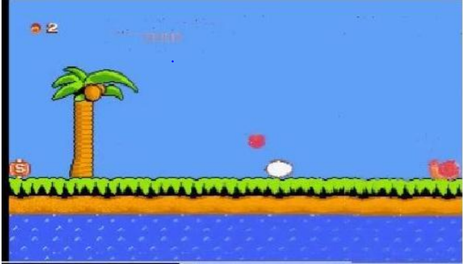
Background Stitching
Establishing a Background Model
Target Recognition
Video Repairing
using affine transformation and median filter method

Slide 10
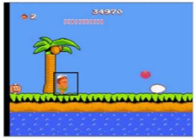
Specify Removed Object
Establishing a Background Model
Target Recognition
Video Repairing
specify a bounding box around an object for removal in the first frame the object appeared

Slide 11
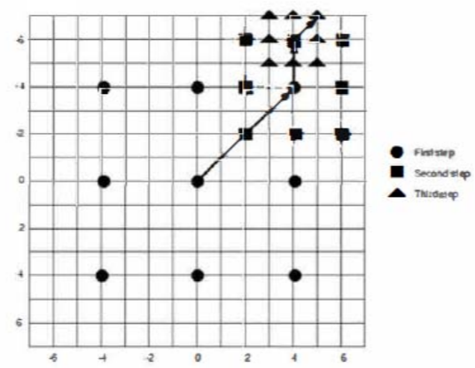
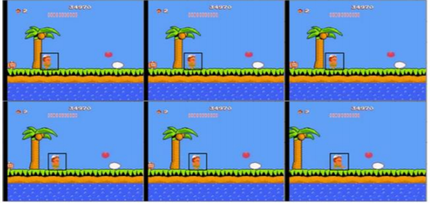
Object Tracking
Establishing a Background Model
Target Recognition
Video Repairing
use the three-step search (TSS) for object tracking

Slide 12
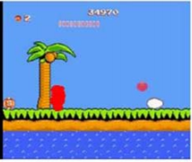
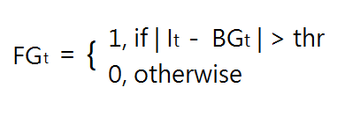
Background Subtraction
Establishing a Background Model
Target Recognition
Video Repairing
take the absolute to the difference between dynamic background model denoted as BGt and the frame It
then use a threshold to determine a pixel in the frame is belong to foreground or background
Notes:
Frame after removal of specified object

Slide 13
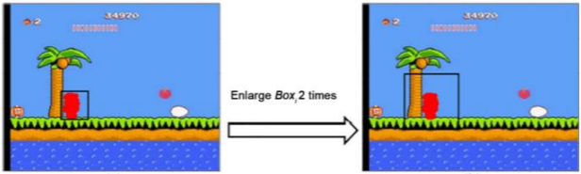
Establish Source Image Region
Establishing a Background Model
Target Recognition
Video Repairing
use the characteristics of video by searching the surrounding information of removed area using the motion vector method to establish the source area image
Enlarge the w x h bounding box to the size of 2w x 2h

Slide 14
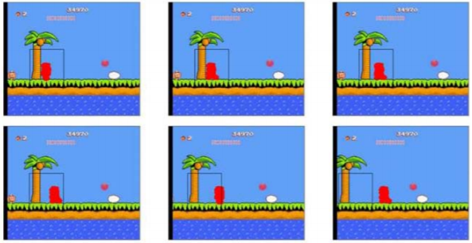
Establish Source Image Region
Establishing a Background Model
Target Recognition
Video Repairing
track the enlarged boxes among the consecutive 20 frames and link all traced together to establish the source region image
traced areas
result of source image region

Slide 15
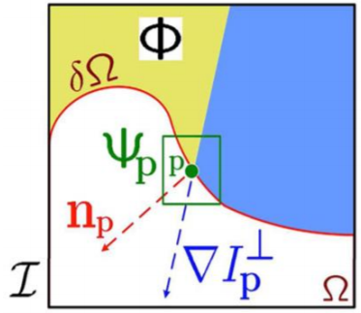
Examplar-based Video Repair
Establishing a Background Model
Target Recognition
Video Repairing
define the damaged region as Ω
a fixed sized block with the center point p,
an arbitrary point on the contour of Ω
is defined as the patch Ψp
the priority of all patches will be calculated to
determine the repairing order
Notes:
The order is important for getting a good quality of repaired result
Fig. is a diagram of symbol definitions in the exemplar-based method

Slide 16
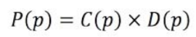
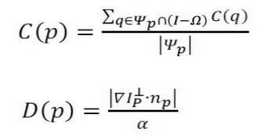
Examplar-based Video Repair
Establishing a Background Model
Target Recognition
Video Repairing
the priority of each patch is calculated using the following equation:
Where C(p) is the confidence term, D(p) is the data term
Notes:
where C(p) is the confidence term, which is computed by the percentage of unbroken areas of any patch on the target area boundary,
and D(p) is the data term, which is calculated by the inner product between the unit vector perpendicular to the edge of the contour and its isophote value.

Slide 17
Examplar-based Video Repair
Establishing a Background Model
Target Recognition
Video Repairing
after finding the priorities of candidate patches,
we use the following equation to find the most similar blocks

Slide 18
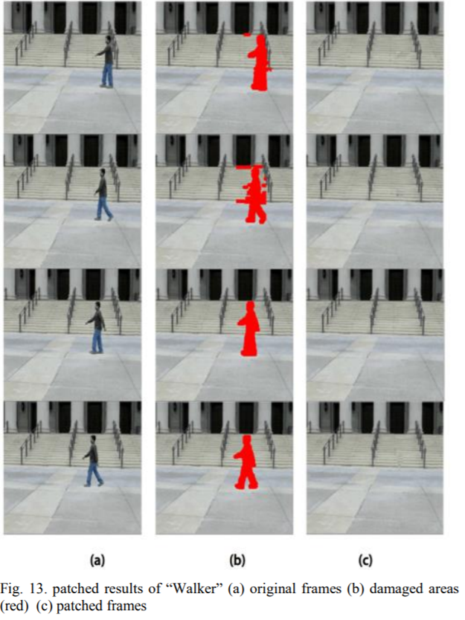
Expected Results

Slide 19
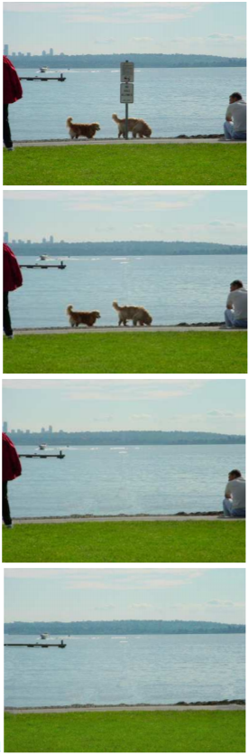
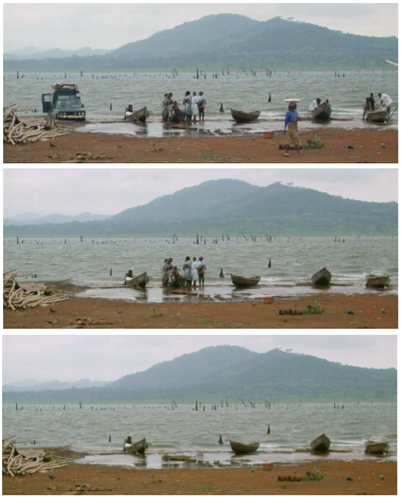
Expected Results
Removing multiple objects

Slide 20
Improvement
Motion consistency

Slide 21
References
A. Criminisi, P. Perez, and K. Toyama (2004), "Region filling and object removal by exemplar-based image inpainting," IEEE Transactions on Image Processing, Vol. 13, No. 9, pp. 1200-1212
Kuo-Lung Huang, Shih-che Lai (2017), “Exemplar-based video inpainting approach using temporal relationship of consecutive frames,” IEEE 8th International Conference on Awareness Science and Technology (iCAST)

